Slide 1

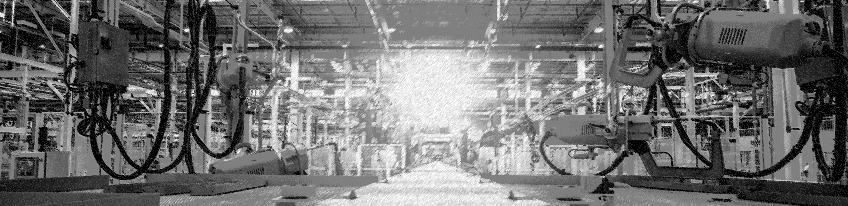

ES2D8
Technical Operations Management
W2-Manufacturing Operations
Dr. Adriana Smith Ortiz
Adriana.Smith-Ortiz@warwick.ac.uk
1

Slide 2
Learning Objectives
Understand how to translate products/services into manufacturing requirements.
Differentiate types of processes and explain their characteristics.
Identify the elements to consider when designing manufacturing processes.
Identify and describe different types of layouts.
Understand the role of Lean approach to ensure the efficient management of manufacturing operations.

Slide 3
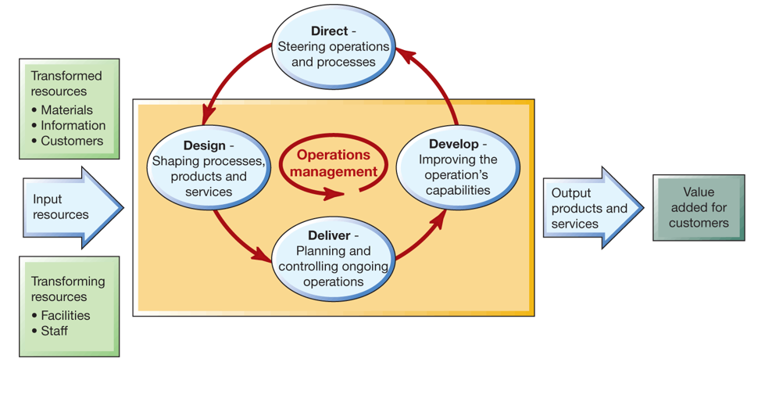
Operations Management context-Recap
Slack, Nigel, and Alistair Brandon-Jones. Operations Management, Pearson Education, Limited, 2019. ProQuest Ebook Central, http://ebookcentral.proquest.com/lib/warw/detail.action?docID=5751937 .
3
Notes:
All operations are input-transformation-output process

Slide 4







Product and Process Design
The design elements for both type of industries services (intangible) and manufacturing (tangible) are equally important.
Operations:
What are the production needs of the proposed new product and how do they match our existing resources?
Will we need new facilities and equipment?
Do we have the labor skills to make the product?
Can the material for production be readily obtained?
Marketing:
What is the potential size of the market for the proposed new product?
How much effort will be needed to develop a market for the product, and what is the long-term product potential?
Finance:
The production of a new product is a financial investment like any other.
What is the proposed new product’s financial potential, cost, and return on investment?
Idea Development
Preliminary Desing & Testing
Product Screening
Final Desing
Notes:
The design elements such as materials, dimensions, blueprints are typical of manufacturing and retail industries in which the product is tangible. For service industries, where the product is intangible. The design elements are equally important but the have an added dimension. Service design is unique in that both the service and the entire service concept are being design. As with the tangible product, the service concept is based on meeting the customer needs. The service design, however adds the aesthetic and psychological benefits of the product. These are the service elements of the operation such as promptness and friendliness. They also incoude the ambiance, image and feel-good elements of the service.
Product Screening: after the prioduct idea has been develop it is evaluated to determine its likehood of success. This is called product screening
The company’s product screening team evalues the product idea according to the needs of the major businesses functions. In their evaluation executives from each function area may explore issues such us:
Operations ….
Unfortunately, there is magic formula for deciding wether or not to pursue a particular product idea. Manageriula skill and experience are key. Companies generate new ideas al the time, approximately 80 percentage of the ideas do not make the sceening stage.
Management analyses operations, marketing and financial factors and then makes the final decision. Fortunately, we have decision- making tools to help us evaluate new products ideas. a popular one is break-even analysis.

Slide 5
Factors Impacting Product Desing
Designing the product or service
Designing the process
The design of products/services and the design of processes are interrelated and should be treated together.
Desing for Manufacture
Desing simplification
Desing standardization
Minimize parts
Desing parts for different products.
Use modular design.
Avoid tools.
Simplify operations.
5
Notes:
The design elements such as materials, dimensions, blueprints are typical of manufacturing and retail industries in which the product is tangible. For service industries, where the product is intangible. The design elements are equally important but the have an added dimension. Service design is unique in that both the service and the entire service concept are being design. As with the tangible product, the service concept is based on meeting the customer needs. The service design, however adds the aesthetic and psychological benefits of the product. These are the service elements of the operation such as promptness and friendliness. They also incoude the ambiance, image and feel-good elements of the service.

Slide 6
Translating into manufacturing requirements
Decisions related to the design of the production process such as:
What is the potential demand?
What are the production capacity need of your product?
How will the goods and services flow through the facility?
What are the space requirements?
Can we afford to be technologically advance, or do we need to invest in new equipment/tools/ fixtures?
6

Slide 7
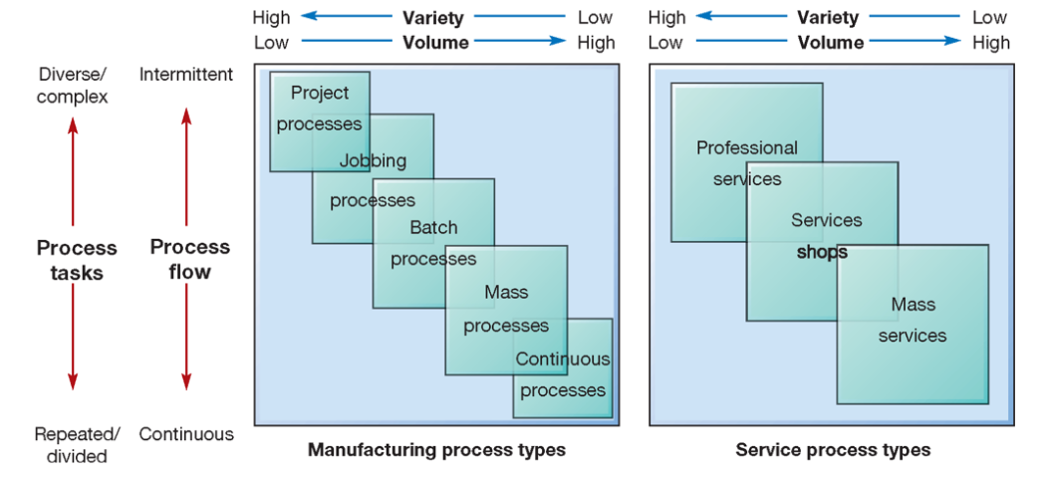
Process Types
Slack, Nigel, and Alistair Brandon-Jones. Operations Management, Pearson Education, Limited, 2019. ProQuest Ebook Central, http://ebookcentral.proquest.com/lib/warw/detail.action?docID=5751937 .
7
Notes:
All operations are input-transformation-output process

Slide 8
Designing Processes: Competitive Priorities
Intermittent Operations
Delivery
Flexibility
Quality
Repetitive Operations
Cost
Quality
8
© WMG 2024
© WMG 2024
Notes:
Cost- offering a product to low relative price to prices of competing products.
Who are your competitors?
Your operations should be plan keeping in mind cost as at competitive priority but LOW COST DOES NOT IMPLY LOW QUALITY.
We focus on cutting cost by improving the system for example using Lean approaches/ continuous improvement.
Here is the trade-off low/ high volume?
Low or high customisation
Mass production or Mass customisation?
Quality has two dimensions, high quality design and process quality.- TQM
Time
This competitive priority focus on speed and on-time delivery… think about the dilemma the “Made in Britain” as consequence of Brexit and Covid and the impact on supply chain/ benefit of reshoring back to Britain.
MG cars now built in China - Welcome to MG | MG MOTOR UK
Raleigh cycles - Raleigh Bikes | Buy Raleigh Bikes Online | Raleigh UK
Morphy Richards - Morphy Richards – Morphy Richards-UK being produces in the far east
Returning to UK
Bohoo, Ted Baker
Benefits of returning local production
Reducing products carbon footprint
Reducing lead times and delivery cost
Ensuring quality by continued monitoring rather than relying on samples

Slide 9
Process Selection
Slack, Nigel, and Alistair Brandon-Jones. Operations Management, Pearson Education, Limited, 2019. ProQuest Ebook Central, http://ebookcentral.proquest.com/lib/warw/detail.action?docID=5751937 .
9
Notes:
All operations are input-transformation-output process

Slide 10
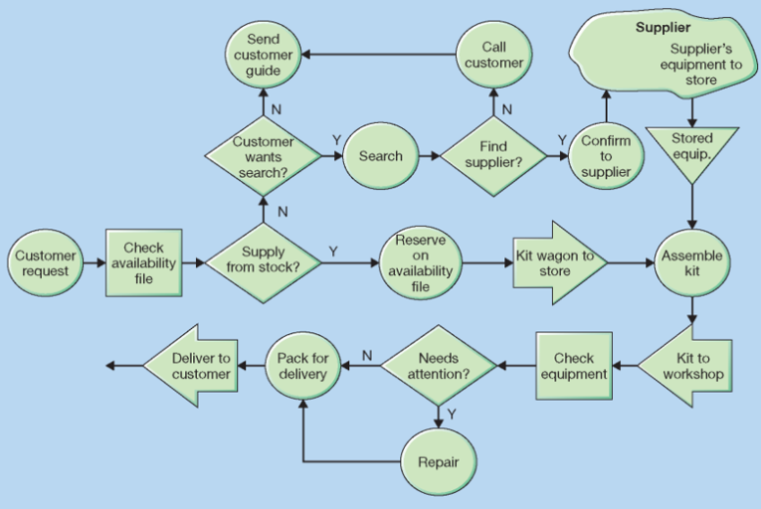
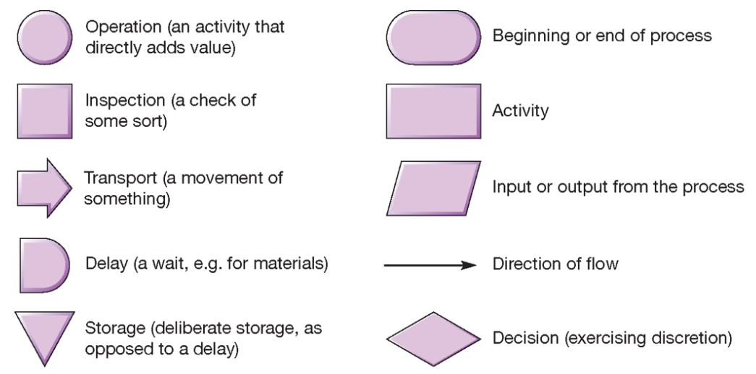
Designing Processes: Process Flow Analysis
Flowchart
Slack, Nigel, and Alistair Brandon-Jones. Operations Management, Pearson Education, Limited, 2019. ProQuest Ebook Central, http://ebookcentral.proquest.com/lib/warw/detail.action?docID=5751937 .
10
© WMG 2024
© WMG 2024
Notes:
Different process types imply different volume-variety characteristics for the process

Slide 11

Designing Processes:
A
8 min
B
10 min
C
15 min
D
13 min
What is the maximum output capacity per hour for the flowline shown?
How can this problem be resolve?
11
© WMG 2024
© WMG 2024
Notes:
Different process types imply different volume-variety characteristics for the process

Slide 12
Designing Processes: Facility Location
Factors affecting Location decisions:
Proximity to sources of supply
Proximity to customers
Proximity to source of labour
Community considerations
Site considerations
Quality-of-life Issues
Other considerations
Globalization
“Made in Britain”
Step 1
Identify Dominant Location Factors
Step 2
Develop Location Alternatives
Step 3
Evaluate Location Alternatives
12
© WMG 2024
© WMG 2024
Notes:
Supply chain disruptions
MG cars now built in China - Welcome to MG | MG MOTOR UK
Raleigh cycles - Raleigh Bikes | Buy Raleigh Bikes Online | Raleigh UK
Morphy Richards - Morphy Richards – Morphy Richards-UK being produces in the far east
Returning to UK
Bohoo, Ted Baker
Benefits of returning local production
Reducing products carbon footprint
Reducing lead times and delivery cost
Ensuring quality by continued monitoring rather than relying on samples
Evaluate location Alternatives – Using factor rating or other models such distance models

Slide 13
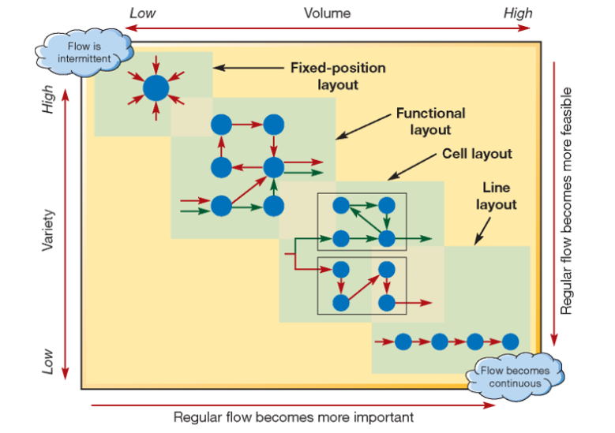
Designing Processes: Layout Planning
Deciding on the best physical arrangement of all resources that consume space within a facility.
Common types of layouts:
Functional Layout
Line Layout
Cell Layout
Slack, Nigel, and Alistair Brandon-Jones. Operations Management, Pearson Education, Limited, 2019. ProQuest Ebook Central, http://ebookcentral.proquest.com/lib/warw/detail.action?docID=5751937 .
13
© WMG 2024
© WMG 2024
Notes:
Supply chain disruptions
MG cars now built in China - Welcome to MG | MG MOTOR UK
Raleigh cycles - Raleigh Bikes | Buy Raleigh Bikes Online | Raleigh UK
Morphy Richards - Morphy Richards – Morphy Richards-UK being produces in the far east
Returning to UK
Bohoo, Ted Baker
Benefits of returning local production
Reducing products carbon footprint
Reducing lead times and delivery cost
Ensuring quality by continued monitoring rather than relying on samples
Evaluate location Alternatives – Using factor rating or other models such distance models

Slide 14
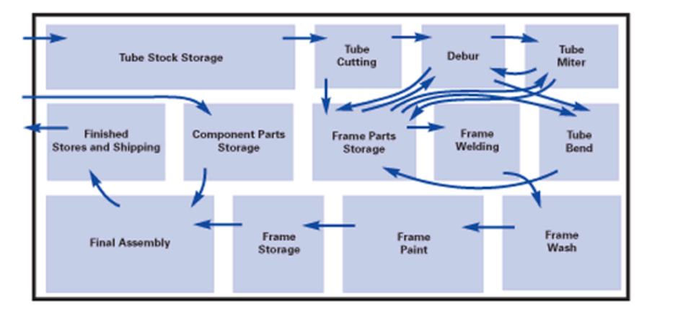
Examples of Layouts
High volume/low cost/ mass production,
Made-to stock, convenient movements
Product/Line layout
Functional layout
Cut
Debur
Bend
Weld
Assemble
Debur
Debur
Bend
Mill
Pack
Mill
Form
Weld
Polish
Assemble
High utilization of equipment, High WIP, inefficient movements, complex flow, difficult to control
14
© WMG 2024
© WMG 2024
Notes:
Supply chain disruptions
MG cars now built in China - Welcome to MG | MG MOTOR UK
Raleigh cycles - Raleigh Bikes | Buy Raleigh Bikes Online | Raleigh UK
Morphy Richards - Morphy Richards – Morphy Richards-UK being produces in the far east
Returning to UK
Bohoo, Ted Baker
Benefits of returning local production
Reducing products carbon footprint
Reducing lead times and delivery cost
Ensuring quality by continued monitoring rather than relying on samples
Evaluate location Alternatives – Using factor rating or other models such distance models

Slide 15
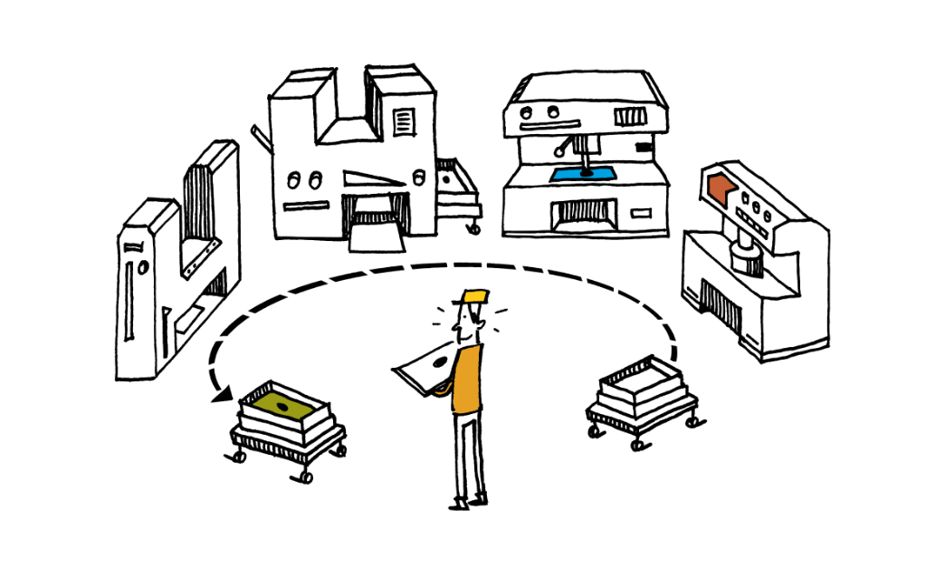
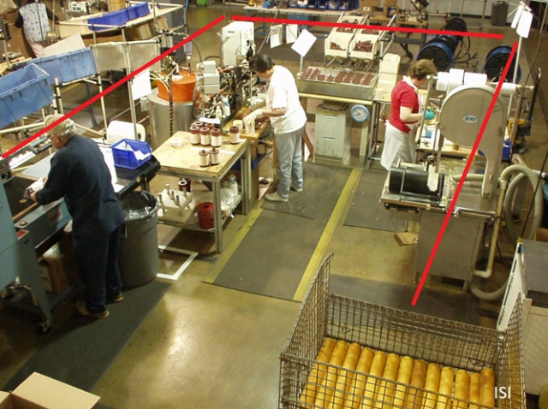
Examples of Layouts
Can be costly to rearrange, can need more equipment which could lead to lower equipment utilisation but high workforce utilization
Cell layout
Supports customisation
Flexibility
Short lead times
Fast throughput
For high variety operations
15
© WMG 2024
© WMG 2024
Notes:
Supply chain disruptions
MG cars now built in China - Welcome to MG | MG MOTOR UK
Raleigh cycles - Raleigh Bikes | Buy Raleigh Bikes Online | Raleigh UK
Morphy Richards - Morphy Richards – Morphy Richards-UK being produces in the far east
Returning to UK
Bohoo, Ted Baker
Benefits of returning local production
Reducing products carbon footprint
Reducing lead times and delivery cost
Ensuring quality by continued monitoring rather than relying on samples
Evaluate location Alternatives – Using factor rating or other models such distance models

Slide 16
Designing Processes: Capacity Planning
Establishing the output rate that can be achieved by the facility.
Capacity planning: The process of establishing the output rate that can be achieved by a facility.
Considerations:
High Volume- Low variety or High variety-Low volume?
Mass production or mass customisation?
Type of Business | Input Measures of Capacity | Output Measures of Capacity
Car manufacturer | Labour hours | Car per shift
Retail Store | Floor space in square feet | Revenues per day
Pizza shop | Worker hours per day | Number of pizzas per day
Ice-cream manufacturer | Operational hours per day | Gallons of Ice cream per day
Examples of different capacity measures
16
© WMG 2024
© WMG 2024
Notes:
Different process types imply different volume-variety characteristics for the process

Slide 17
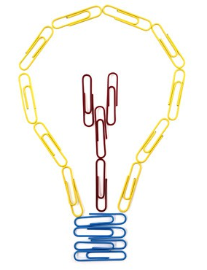

Lean in Manufacturing Operations
Focus on improving operations by reducing waste and improving the ratio of Value added operations to Non-value added and Waste
Maximise
Operation Time /Lead Time
OPERATOR TIME
Waste
NVA
VA
Waste
NVA
VA
Eliminate
Reduce
NVA
Waste
NVA
VA
VA
Operation Time /Lead Time
Lean is about working smarter, not working harder!
17
© WMG 2024
© WMG 2024
Notes:
Different process types imply different volume-variety characteristics for the process

Slide 18
Lean Principles
1.Specify Value
2.Identify Value Stream
3.Flow
4.Pull
5.Perfection
Source: Womack, JP, & Jones, DT 2003, Lean Thinking : Banish Waste and Create Wealth in Your Corporation, Simon & Schuster, Limited, London. Available from: ProQuest Ebook Central.
18
© WMG 2024
© WMG 2024
Notes:
Different process types imply different volume-variety characteristics for the process

Slide 19

Thank you.
Do you have any questions?
Q&A
19
© WMG 2024

